Slide 1
WHAT IS Git?
It is a free and open source distributed system focussing on speed and data integrity, originally developed in 2005 by Linus Torvalds.
Git is a version control system also known as a VCS – Version Control System.
Now, a VCS is basically a software designed to record changes made to a file or set of files overtime. It has the option of branching with easy to merge option.
These fully-functional local repositories make it is easy to work offline or remotely. We commit our work locally, and then sync the copy of our repository with the copy on the server.

Slide 2
FEATURES OF GIT
We can imagine git as something that sits on top of our file system and manipulates them.
The overall structure is somewhat of a “tree”, where each commit creates a new node.
Nearly all git commands actually serve to navigate on this tree and to manipulate it accordingly.
Most of the version control systems have a two-tier architecture, but Git has a layer more, making it a three-tier architecture

Slide 3
The Architecture Workflow
Working_Dir
Staging Area
(index)
Local Repository
Stage files (Git add)
Git Command
Git Checkout

Slide 4
The three layers are:
Working directory: This is created when a Git project is initialized onto your local machine and allows you to edit the source code copied.
Staging area: Post the edits, the code is staged in the staging area by applying the command, git add. This displays a preview for the next stage. In case further modifications are made in the working directory, the snapshots for these two layers will be different. However, these can be synced by using the same ‘git add’ command.
Local repository: If no further edits are required to be done, then you can go ahead and apply the git commit command. This replicates the latest snapshots in all three stages, making them in sync with each other.

Slide 5
VCS - Version Control System
A version control system is a software that tracks changes to a file or set of files over time so that you can recall specific versions later. It also allows you to work together with other programmers.
It is a collection of software tools that help a team to manage changes in a source code. It uses a special kind of database to keep track of every modification to the code
Provides ease of access – Several developers can work on a project simultaneously.
Changes can be reverted back easily.
Two categories of VCS – Centralized and Distributed (Check the next 2 slides.)

Slide 6
Centralized Version Control System
In CVCS, The repository is placed at one place and delivers information to many clients.
It is based on the client-server approach.
It is the most straightforward system based on the concept of the central repository.
In CVCS, the server provides the latest code to all the clients across the globe.
CVCS is easy to administrate and has additional control over users and access by its server from one place.
If the server fails, No system can access data from another system.
Distribute Version Control System
In DVCS, Every user has a local copy of the repository in place of the central repository on the server-side.
It is based on the client-server approach.
It is flexible and has emerged with the concept that everyone has their repository.
In DVCS, every user can check out the snapshot of the code, and they can fully mirror the central repository
DVCS is fast comparing to CVCS as you don't have to interact with the central server for every command.
if any server fails and other systems were collaborating via it, that server can restore any of the client repositories

Slide 7
Centralized
Distributed
Server
Repository
System A
Update/Commit
Push/Pull
System A
Commit/Replace
Server
Repository
Server
Repository
Push/Pull
Update/Commit
System B
Server
Repository
Commit/Replace
System B

Slide 8
How to use Git?
Workspace
Staging
Local Repository
Remote Repository
Git add/mv/rm
Git Commit
Git Commit-a
Git Push
Git Reset<file>
Git Reset <Commit>
Git Fetch
Git Clone/Pull

Slide 9
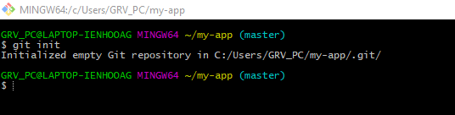
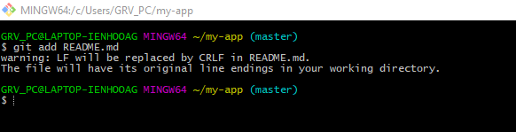
Git Commands
Git INIT: git init to initialize a Git repository for our local project folder. Git will create a hidden .git directory and use it for keeping its files organized in other subdirectories.
Git ADD: This will add the specified file(s) into the Git repository, the staging area, where they are already being tracked by Git and now ready to be committed.

Slide 10
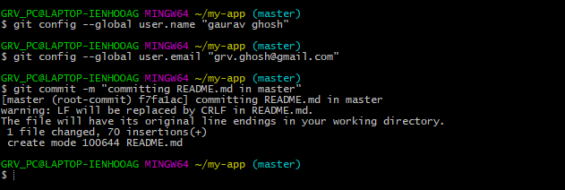
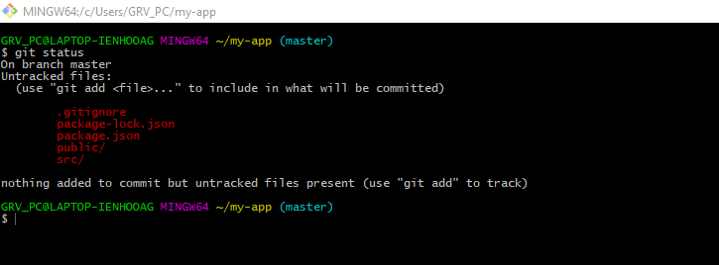
Git COMMIT: This command records or snapshots files permanently in the version history. All the files, which are there in the directory right now, are being saved in the Git file system.
Git STATUS: This command will show the modified status of an existing file and the file addition status of a new file, if any, that have to be committed.

Slide 11
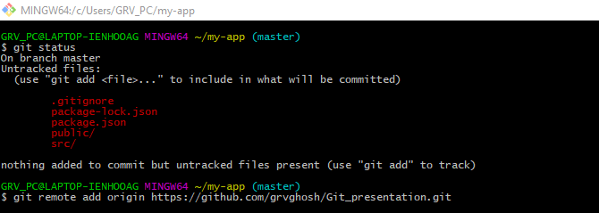
Git REMOTE: Once everything is ready on our local system, we can start pushing our code to the remote (central) repository of the project.
Eg. git remote add origin “URL”

Slide 12
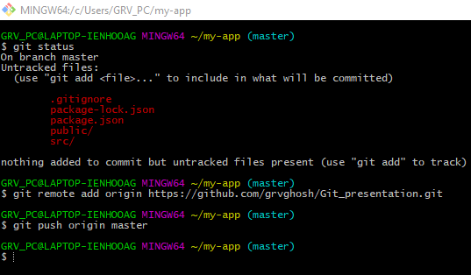
Git REMOTE: eg: Once everything is ready on our local system, we can start pushing our code to the remote (central) repository of the project.
git remote add origin “URL”
Git PUSH: Suppose, we have made some changes in the file and want to push the changes to our remote repository on a particular branch. By using the command ‘git push,’ the local repository’s files can be synced with the remote repository on Github.

Slide 13
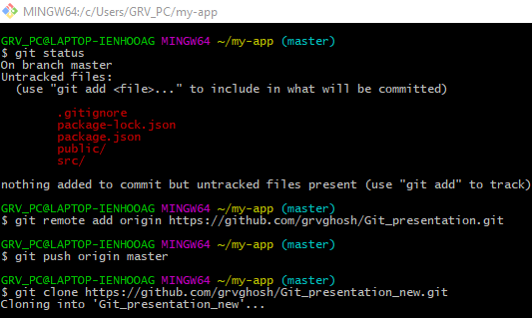
Git CLONE: Suppose, we want to work on a file that is on a remote Github repository as another developer. How can we do that? We can work on this file by clicking on Clone or Download and copying the link and pasting it on the terminal with the git clone command. This will import the files of a project from the remote repository to our local system.

Slide 14


Git BRANCH: multiple developers working on the same project or repository! To handle the workspace of multiple developers, we can use branches. To create a branch..
To delete a branch..

Slide 15

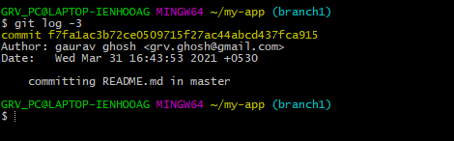
Git CHECKOUT: We use this command to navigate to an existing branch, add new files, and commit the files:
Git LOG: This command is used when we want to check the log for every commit in detail in our repository.
Note: It will show the log of the branch we are in. We can check the last three logs by giving the command: git log -3

Slide 16
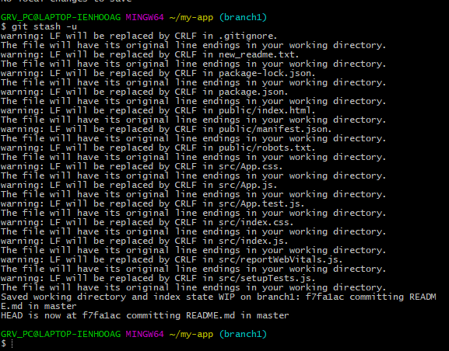
Git STASH: This command can be used when we want to save our work without staging or committing the code to our Git repository and want to switch between branches

Slide 17

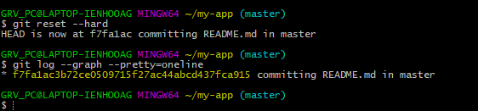
Git MERGE:This command will combine multiple sequences of commits into one unified history. In the most frequent use cases, git merge is used to combine two branches. The git merge command takes two commit pointers, usually the branch tips, and finds a common base commit between them. Once it finds a common base commit, it will create a commit sequence.
Git RESET: We use this command to return the entire working tree to the last committed state.

Slide 18
ADVANTAGES OF GIT
Distributed model: Our work is private. Others can see only what’s necessary. Other advantages include speed (since most everything is local) and possibility of working offline.
Branching and merging are easy: It feels like a natural part of the workflow. They are cheap so that we can branch whenever we want.
Workflow is flexible: Git has the qualities that allow to choose your own workflow. It can be as simple as a centralised workflow to as hierarchical as the dictator-lieutenant workflow. Use the process that best fits us.
Data integrity is assured: Because git uses trees, data corruption due to external reasons can be easily detected.

Slide 19
DISADVANTAGES OF GIT
Even though Git seems like the perfect solution for various problems related to the software development life cycle (SDLC), it has its shortcomings.
Its steep learning curve itself is a disadvantage, which is due to the non-intuitive nature of its commands. A much deeper understanding of the internals of Git is needed to avoid inconsistencies.
Git doesn't handle Binary files well. Whenever files containing non-text content are updated or used, Git gets slowed down.
It does create a conducive environment for a large number of developers distributed over a large geographical area but, at the same time, creates a lot of conflict and confusion while merging codes.

